Slide 1
The Analysis and Design of Computer Algorithms
CIS*3490 Winter 2021

Slide 2
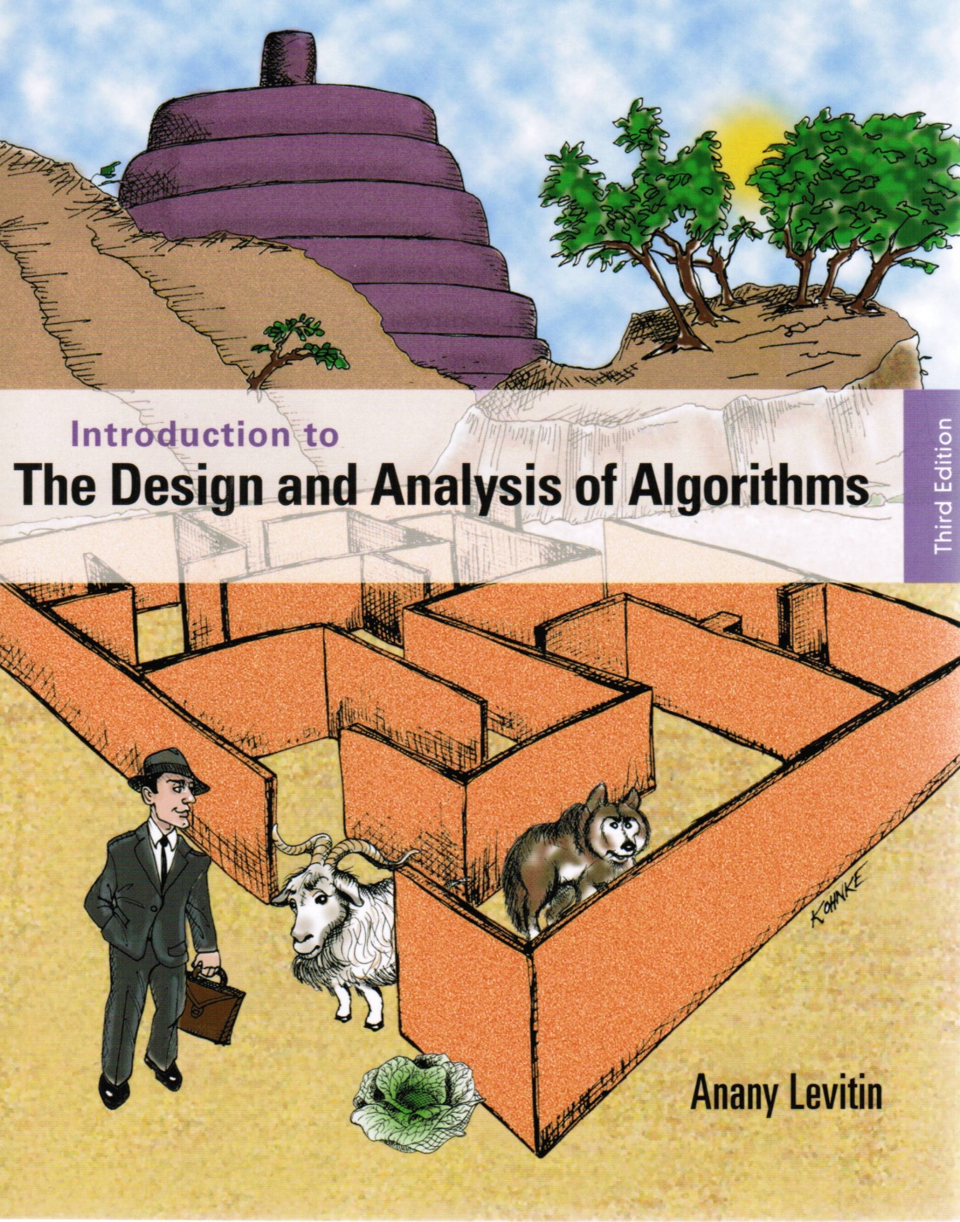
Chapter 1
Introduction

Slide 3

What is an Algorithm?
An algorithm is a sequence of unambiguous instructions for solving a problem, i.e., for obtaining a required output for any legitimate input in a finite amount of time.
problem
algorithm
computer program
input
output

Slide 4
What is an Algorithm?
Recipe, process, method, technique, procedure, …, satisfying the following requirements:
Finiteness
terminates after a finite number of steps
Definiteness
rigorously and unambiguously specified
Effectiveness
steps are sufficiently simple and basic
Input
valid inputs are clearly specified
Output
correct output given a valid input
Notes:
The formalization of the notion of an algorithm led to great breakthroughs in the
foundations of mathematics in the 1930s.

Slide 5
Example of Computational Problem: Sorting
Statement of problem:
Input: A sequence of n numbers <a₁, a₂, …, a_{n}>
Output: A reordering of the input sequence <a´₁, a´₂, …, a´_{n}>
so that a´_{i} ≤ a´_{j} whenever i < j
Instance: The sequence <5, 3, 2, 8, 3>
Algorithms:
Selection sort
Insertion sort
Merge sort
(many others)

Slide 6
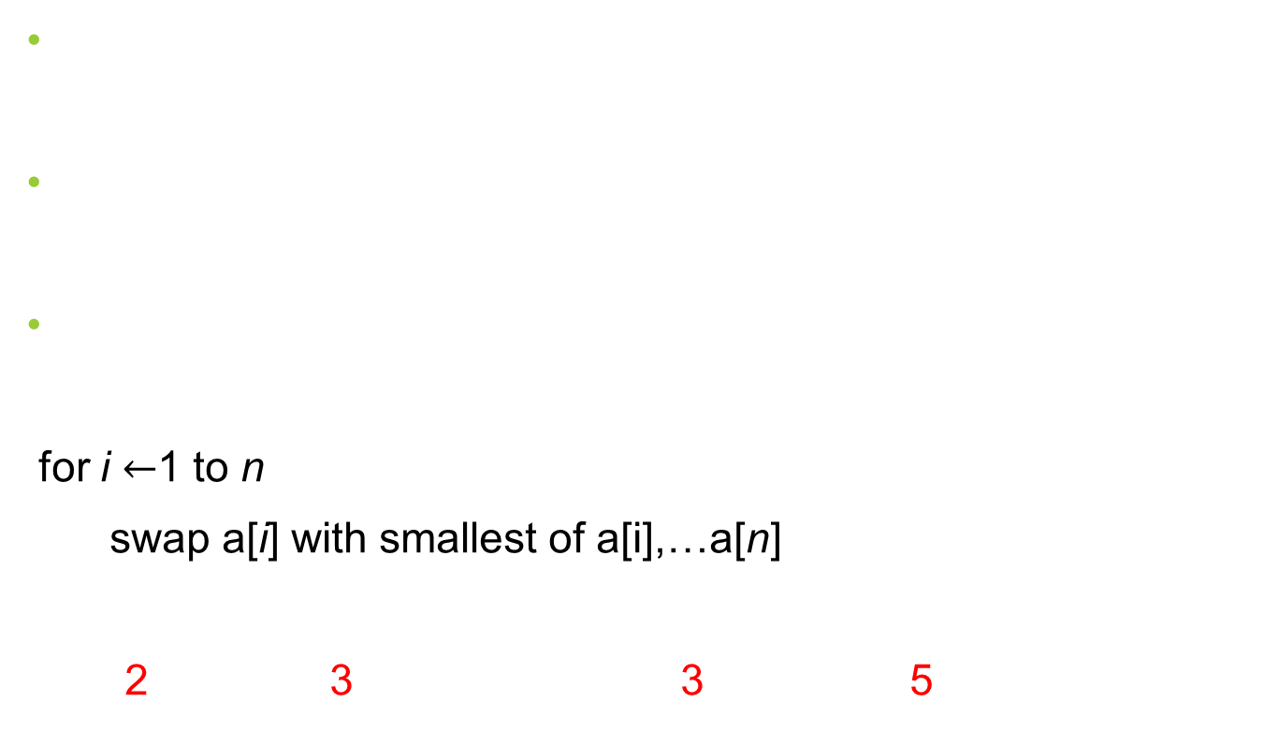
Selection Sort
Input: array of numbers a[1],…,a[n]
Output: array a sorted in non-decreasing order
Algorithm:
for i $←$1 to n
swap a[i] with smallest of a[i],…a[n]
<5,3,2,8,3> <2,3,5,8,3> <2,3,5,8,3> <2,3,3,8,5> <2,3,3,5,8>
Notes:
The algorithm is given *very* informally here. Show students the pseudocode in
section 3.1.
This is a good opportunity to discuss pseudocode conventions.

Slide 7
Basic Issues Related to Algorithms
How to design algorithms
How to express algorithms
Proving correctness
Efficiency analysis
Theoretical analysis
Empirical analysis
Optimality

Slide 8
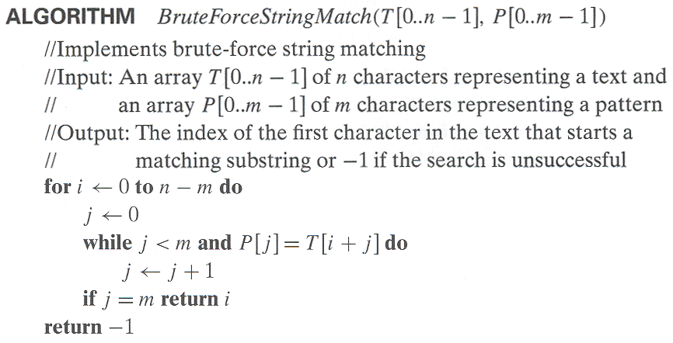
Algorithm Representation
Algorithm name
Parameter list
Keyword ALGORITHM
Descriptive information
Beginning of algorithm body
for loop with condition
Assignment statement
while loop with condition
if statement
return statement

Slide 9
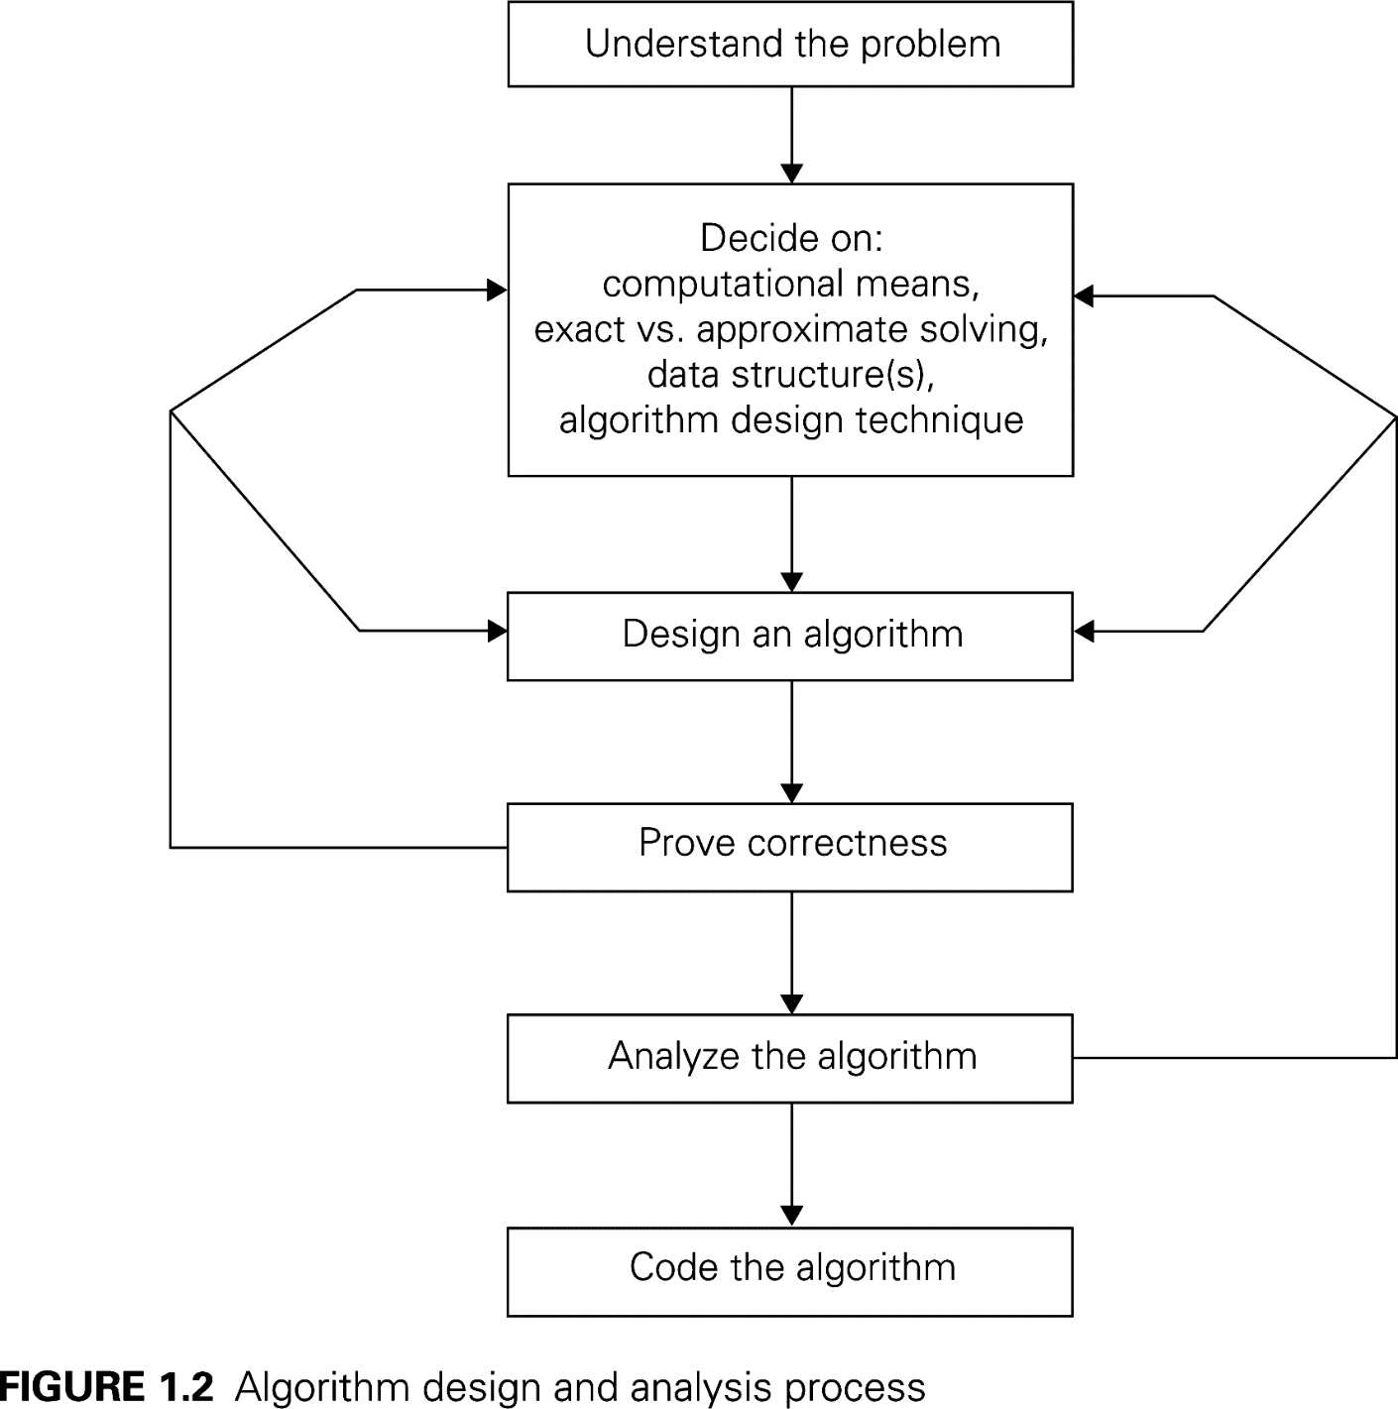
The Two Main Issues
How to design algorithms
How to analyze algorithm efficiency

Slide 10
Analysis of Algorithms
How good is the algorithm?
Correctness
Time efficiency
Space efficiency
Does there exist a better algorithm?
Lower bounds
Optimality

Slide 11
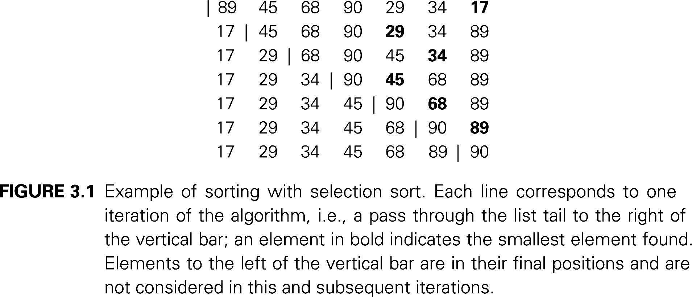

Efficiency: Θ($n^{2}$)

Slide 12
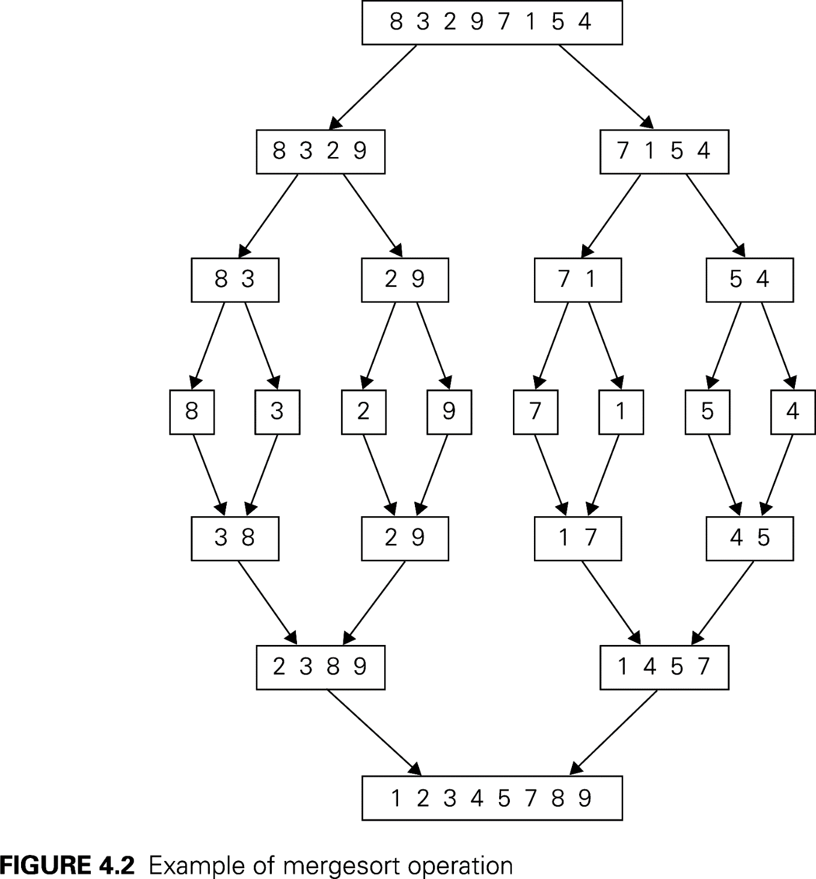

Efficiency: Θ($n\log{n}$)

Slide 13
Algorithm Design Techniques/Strategies
Brute force
Divide and conquer
Decrease and conquer
Transform and conquer
Space and time tradeoff
Greedy approach
Dynamic programming
Iterative improvement
Backtracking
Branch and bound

Slide 14
Important Problem Types
Searching
String processing
Sorting
Tree problems
Graph problems
Other problems, including combinatorial problems, geometric problems, numerical problems, etc.

Slide 15
Design Techniques, Problem Types and Algorithms
 | Search | Sorting | Tree | Graph | Other
Brute force, exhaustive search | Sequential search, Sequential string match | Selection sort, Bubble sort |  | Traveling salesman problem, DFS, BFS | Knapsack problem, Assignment problem
Decrease and conquer | Binary search | Insertion sort | Binary search tree | Topological sorting | Exponentiation by squaring
Divide and conquer |  | Mergysort, Quicksort | Binary tree traversal |  | Matrix multiplication, Large integer multiplication
Transform and conquer | Presorting | Heapsort | AVL tree, 2-3 tree |  | Gaussian elimination, Polynomial evaluation
Space and time tradeoff | Hashing, B-tree, Horspool algorithm | Sorting by counting
Dynamic programming |  |  | Optimal binary search trees | Warshall’s algorithm, Shortest paths problem | Knapsack problem, Memory functions
Greedy techniques |  |  |  | Minimum spanning tree | Huffman trees
Iterative improvement |  |  |  | Maximum flow Bipartite graphs | Stable marriage problem
Backtracking Branch & bound |  |  |  | Traveling salesman problem, | N-queens, Assignment, Knapsack

